Slide 2
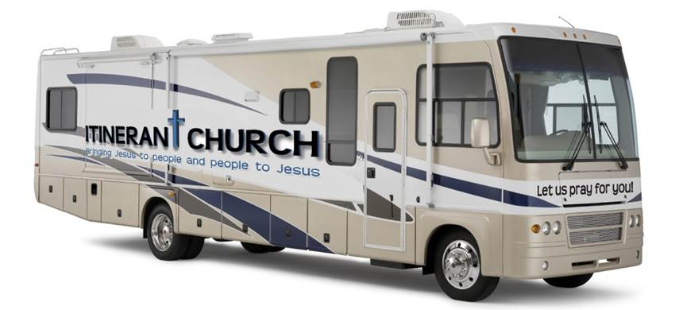

Slide 3
COMMISSION
COMMISSION
GO then and make
disciples of all nations,
baptizing them in the name of the Father
and of the Son and of the Holy Spirit.
Teaching them to observe
everything that I have commanded you, and behold, I am with you all the days,
to the close and consummation of the age.
Matthew 28:19-20

Slide 6
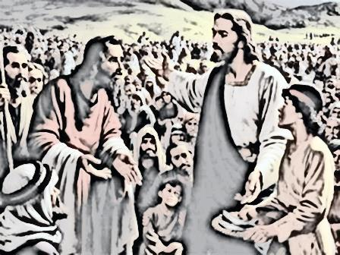
HISTORY
HISTORY
For years I observed in the life of Jesus a pattern of GOING
versus a
waiting to come
approach.
Jesus did GO everywhere to
everyone. He walked, got into a boat, hopped on a donkey and if He had a RV at the time, He would have probably used that too.
I also realized that we need to create an environment that fosters on people’s hearts a disposition to listen to what we have to say about Jesus and to receive what Jesus has for them.

Slide 7
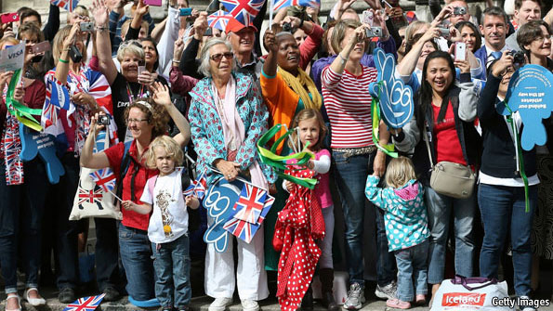
ACTION
ACTION
Jesus did GO
EVERYWHERE to
everyone
Jesus tells us: … Did you not know that I MUST be about My Father’s business? Luke 2:49
Mark 1:38 - “Let us GO into the next towns, that I may preach there also, because for this PURPOSE I have come forth.”
Mark 2:15 - Later, Levi invited Jesus and His disciples to his home as dinner guests, along with many tax collectors and other disreputable sinners. There were many people of this kind among Jesus’ followers.
John 4:3-5 - Jesus left Judea and returned to Galilee. It was necessary for Him to GO …

Slide 8
Approach >>>
Approach >>>
✓ Community and Relationship building
✓ Individual and Group:
Bible Teaching
Divorce care
Prayer Time
✓ Men, Women and Couples counseling

Slide 9
✓ People at camping sites, beaches, RV parking, recreational parks, sports games…
Travelers, bus and truck drivers…
Local residents and motorcycle riders.

Slide 10
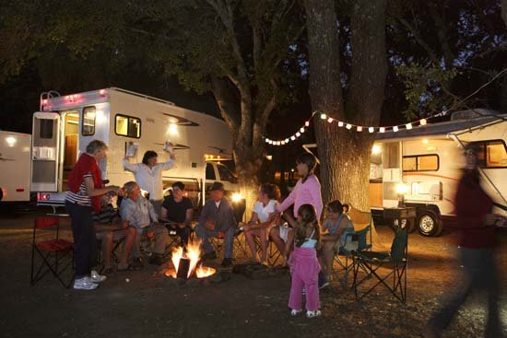
Community
Communion
“For where two or three gather in my name, there am I with them.”
Matthew 18:20

Slide 11
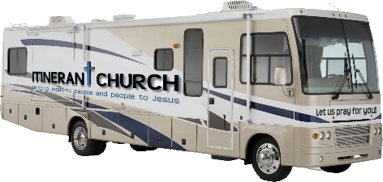
Strategy
Strategy
To travel on a RV … Bringing JESUS to people
and people to JESUS
YouTube Channel videos
Send-off date: God knows ☺
Website: www.ItinerantChurch.org

Slide 12
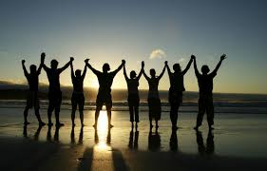
Vision Keepers
Vision Keepers
Pastor John Chinelly
Greg DeTullio
David Baldwin
Melba Gomez

Slide 13
Collaborators
Collaborators
Melba Gomez - Music
Eva Bruno Bertoncini – YouTube Recordings
Rosana Geisweller – YouTube Recordings
Val Harrison – YouTube Recordings
We need help with:
Social Media
Website Maintenance
Accounting
Marketing Materials
Fundraising

Slide 14
Prayer Team
Prayer Team
Isaiah Bazile
Melba Gomez
Sebastien Allaire
Greg DeTullio
David Baldwin
Dax Masterson
Joseph Henry (in memoriam)

Slide 15
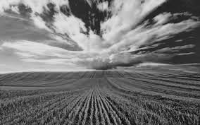
Support/Funding
Support/Funding
Work remotely
Partnerships - Companies, individuals, churches
Fundraising events
May the favor of the Lord our God rest on us; establish the work of our hands for us. Yes, establish the work of our hands! Psalm 90:17

Slide 16
20 Year Vision
RVs crossing the country …
Bringing
JESUS
to
people
and people to JESUS

Slide 17
25 Year Vision
Broadcasting live from remote sites…

Slide 18
OPPORTUNITY
Why are we presenting this vision to you?
Because we prayed about your participation in this mission of “Bringing Jesus to people and people to Jesus” along side with us. You can help out.
“And you …….. yourselves know that in the beginning of the gospel ………. no church entered into partnership with me in giving and receiving, except you only.” Philippians 4:15 ESV
What can we do together in partnership?
You can partner with us in multiple capacities by:
Telling others about the vision. And by asking them to tell others…
Praying and inviting others to pray for this Ministry and for those that will be reached out by us so they will open their hearts to receive and accept Jesus.
Applying your spiritual gift(s) in supporting the vision. Let us know how you can help.
Encouraging people to offer their time, money and other resources to further the vision.

